Slide 1

SyncBazar: Desktop-Based Inventory Management System
Project Name: SyncBazar Type: Desktop-Based Inventory Management System
Designed for local retailers in Pakistan
Multi-store collaborative inventory system
Technologies Used:
Python Tkinter (GUI)
Microsoft SQL Server (Database)
Focus: Practical application of Software Engineering concepts

Slide 2
Slide 2: Problem Statement
Local retailers face multiple challenges:
Manual inventory tracking
No visibility
Frequent stockouts
→ human errors
across multiple stores
→ lost sales
No automated analytics
Poor decision-making
or reporting
due to lack of real-time data

Slide 3

Slide 3: Proposed Solution (SyncBazar)
SyncBazar addresses these problems by providing:
Centralized inventory management
Multi-store synchronization
Network-wide product search
Real-time analytics & reporting
Simple and user-friendly Tkinter-based interface

Slide 4
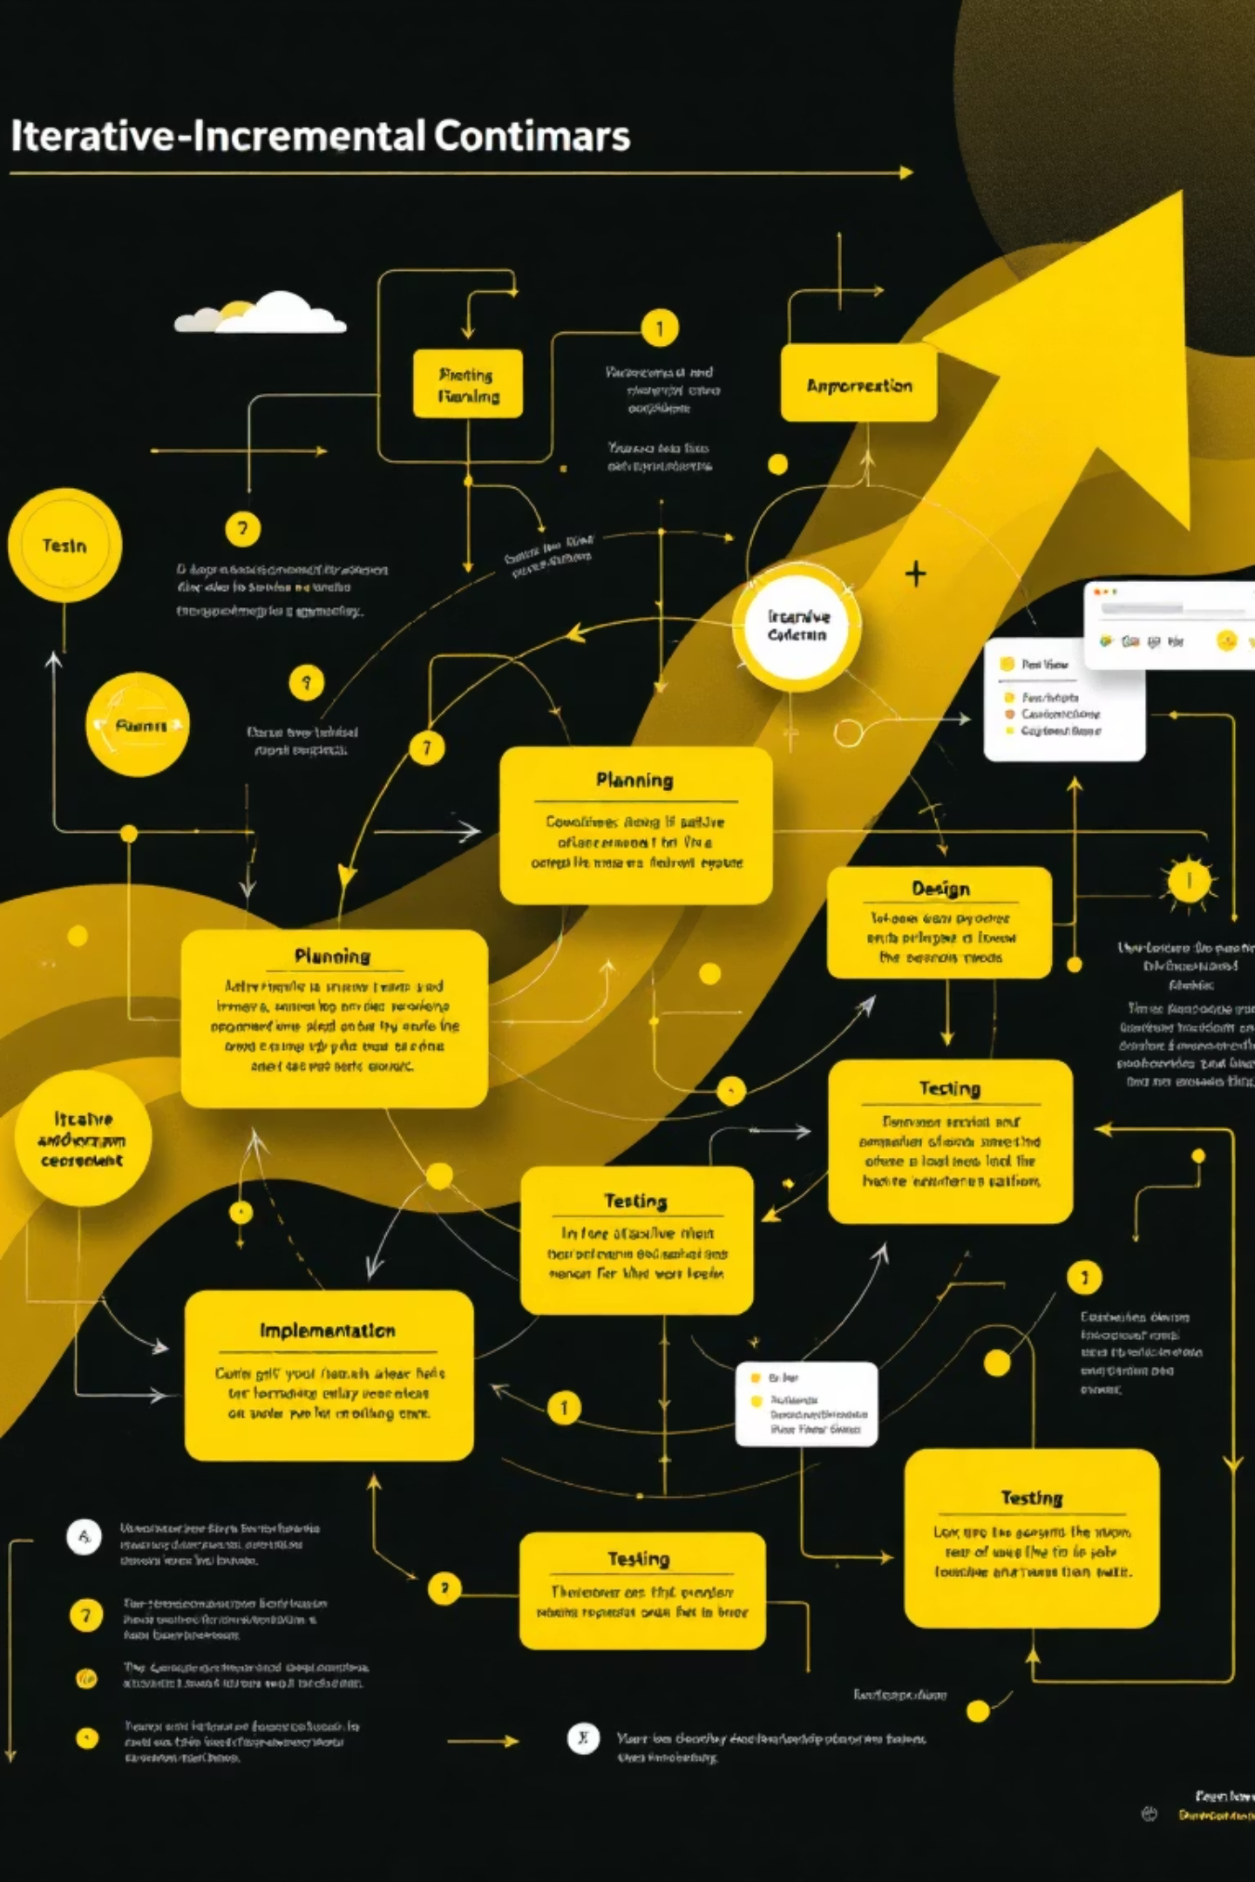
Slide 4: Software Process Model
Selected Model:
Justification:
Iterative-Incremental Model
Reduced risk through small working releases
Continuous feedback incorporation
Proper documentation at each phase
Feature prioritization (basic → advanced)

Slide 5
Slide 5: Iterations Breakdown
Iteration Plan:
01
02
Iteration 1 (Weeks 1–2):
Iteration 2 (Weeks 3–4):
User authentication
Multi-store management
Basic inventory CRUD
SQL database schema
03
04
Iteration 3 (Weeks 5–6):
Iteration 4 (Weeks 7–8):
Network search
Analytics & reporting
UI improvements
Testing & optimization

Slide 6

Slide 6: Software Process Improvement (SPI)
SPI Initiatives Implemented:
Improvements Achieved:
Structured code review checklist
Code coverage increased to 72%
Automated unit & integration testing
Bug detection time reduced by 60%
Standardized documentation
Regression testing time reduced by 75%

Slide 7

Slide 7: Version Control & Deployment
Version Control:
Deployment Management:
GitHub repository
Feature-based branching
Development, Testing, Production environments
Pull requests & milestones
Deployment artifacts:
INSTALL.md
sync.sql
config.py
User Manual

Slide 8

Slide 8: Lehman’s Laws & Refactoring
Lehman’s Laws Applied:
Refactoring Activities:
Continuous change through feature updates
Monolithic → modular architecture
Increasing complexity managed via modular design
Removed duplicate code
Replaced hard-coded values
Stability ensured through testing & reviews
Updated legacy Tkinter methods

Slide 9

Slide 9: Testing, Reviews & Teamwork
Testing Implemented:
Peer Review Practices:
Team Collaboration:
Unit tests
Pair programming
Clear role division
Integration tests
Regression tests
Walkthroughs
Regular meetings
Automated testing pipeline
Formal inspections
Knowledge-sharing sessions

Slide 10

Slide 10: Results & Conclusion
Project Achievements:
Final Outcome:
Fully functional inventory management system
SyncBazar successfully demonstrates real-world software engineering practices in an academic project.
All software engineering concepts implemented
High-quality, maintainable, and tested code
Strong collaboration between team members
Complete technical & user documentation

